Slide 1
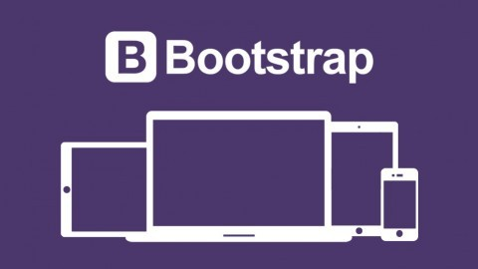
Tesfaye Gari
MTM IT Training
Sr System and Application Architect

Slide 2
2/6/2019
Bootstrap
2
What is Bootstrap?
Bootstrap is a free front-end framework (HTML and CSS) for faster and easier web development
Bootstrap is famous for being developed with components that have the ability to follow the property of responsive designs
Responsive Design is about using CSS and HTML to resize, hide, shrink, enlarge, or move the content to make it look good on any screen
Responsive Design allow your page works for computer, tablets and mobile phones.

Slide 3
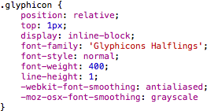
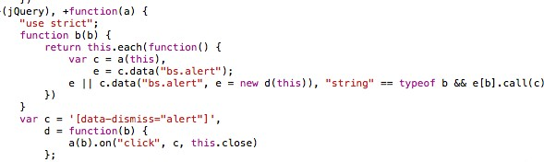
2/6/2019
Bootstrap
3
What is Bootstrap?
In other words, bootstrap is a collection of CSS classes and JavaScript functions that you get ready to use and will not worry about write code like this:

Slide 4
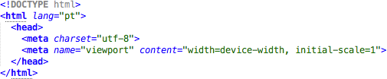
2/6/2019
Bootstrap
4
First Bootstrap Page
Include the HTML5 doctype at the beginning of the page, along with the lang attribute and the correct character set

Slide 5
2/6/2019
Bootstrap
5
First Bootstrap Page
Meta viewport tag ensure proper rendering and touch zooming
Width of the page to follow the screen-width of the device and initial zoom level to default zoom level of device
User will have a better experience, thus will not need zoom the page to view page information

Slide 6
2/6/2019
Bootstrap
6
First Bootstrap Page
You will need to include three files:
bootstrap.min.css
jquery.min.js
bootstrap.min.js
You must download it and include in you page
For this example, we include from the Internet

Slide 7
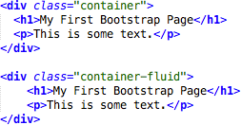
2/6/2019
Bootstrap
7
First Bootstrap Page
Bootstrap has a concept of containing element to wrap site contents

Slide 8
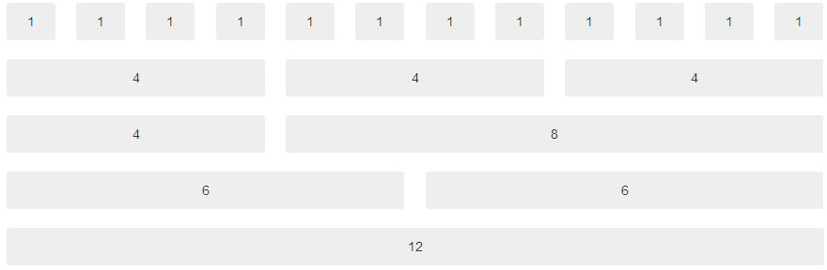
2/6/2019
Bootstrap
8
Bootstrap Grids
Bootstrap's grid system allows up to 12 columns across the page
You can divide the container in rows and each row in columns with space multiple of the 12

Slide 9
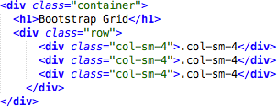
2/6/2019
Bootstrap
9
Bootstrap Grids
In the bellow example, we divide the space inside the container in 1 row and this row in 3 columns with the same side. 4+4+4 = 12
You can use any combination that the sum be equal to 12.

Slide 10
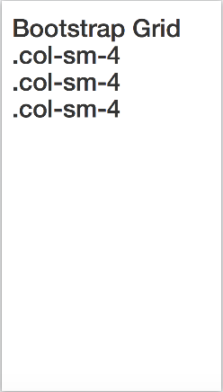
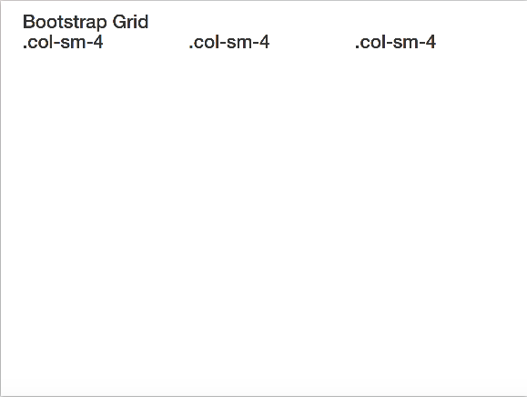
19/03/17
Bootstrap
10
Bootstrap Grids
Responsive Bootstrap's grid system with 3 columns
small screens
big screens

Slide 11
2/6/2019
Bootstrap
11
Bootstrap Table
4 main classes:
.table
.table-striped
.table-bordered
.table-hover
5 contextual classes:
.active
.success
.info
.warning
.danger

Slide 12
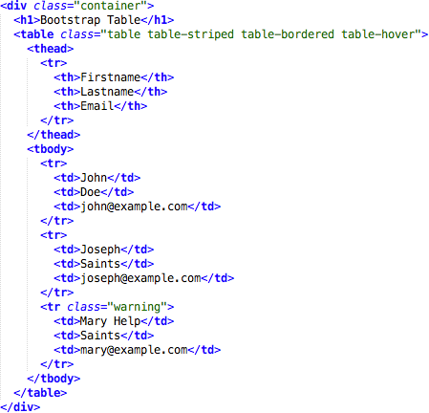
2/6/2019
Bootstrap
12
Bootstrap Tables

Slide 13
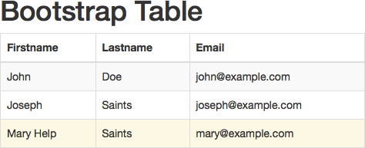
2/5/2019
Bootstrap
13
Bootstrap Tables

Slide 14
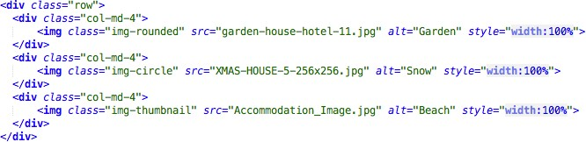
2/6/2019
Bootstrap
14
Bootstrap Images
3 main classes:
. img-rounded
. img-circle
. img-thumbnail

Slide 15
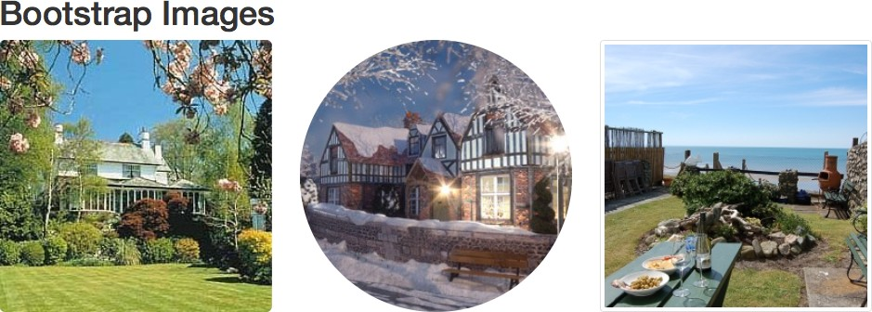
2/6/2019
Bootstrap
15
Bootstrap Images

Slide 16
2/6/2019
Bootstrap
16
Bootstrap Alerts
Bootstrap provides an easy way to create predefined alert messages
Alerts are created with the .alert class, followed by one of the four contextual classes
.alert-success
.alert-info
.alert-warning
.alert-danger

Slide 17
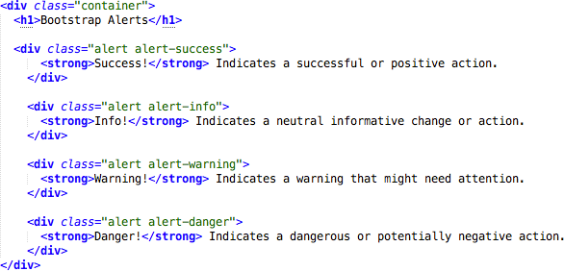
2/6/2019
Bootstrap
17
Bootstrap Alerts

Slide 18
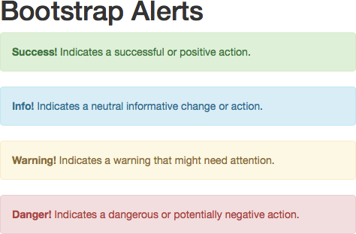
2/6/2019
Bootstrap
18
Bootstrap Alerts

Slide 19
2/6/2019
Bootstrap
19
Bootstrap Buttons
Bootstrap provides seven styles of buttons:
To achieve the button styles above, Bootstrap has the following contextual classes:
.btn-default
.btn-primary
.btn-success
.btn-info
.btn-warning
.btn-danger
.btn-link

Slide 20
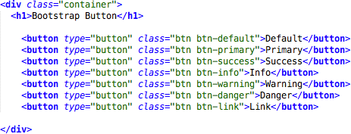
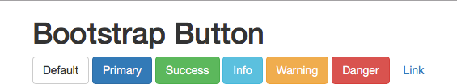
2/6/2019
Bootstrap
20
Bootstrap Buttons

Slide 21
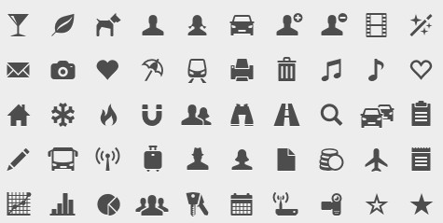
2/6/2019
Bootstrap
21
Bootstrap Glyphicons
Bootstrap provides 260 glyphicons from the Glyphicons Halflings set
(http://getbootstrap.com/components/)

Slide 22
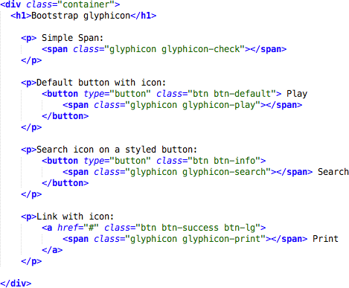
2/6/2019
Bootstrap
22
Bootstrap Glyphicons

Slide 23
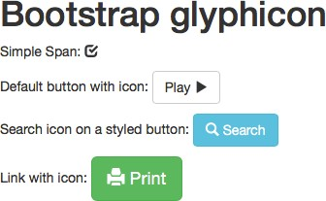
2/6/2019
Bootstrap
23
Bootstrap Glyphicons

Slide 24
2/6/2019
Bootstrap
24
Bootstrap Labels
Labels are used to provide information about something
Bootstrap create labels with colorful backgrounds to highlight the text inside de label
Use the .label class, followed by one of the six contextual classes .label-default, .label-
primary, .label-success, .label-info, .label-warning or .label-danger

Slide 25
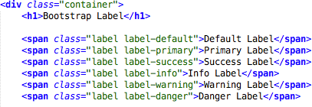

2/6/2019
Bootstrap
25
Bootstrap Labels

Slide 26
2/6/2019
Bootstrap
26
Bootstrap Panels
A panel in bootstrap is a bordered box with some padding around its content that can be use to highlight or separated some information
Like other bootstrap elements panel has contextual classes also (.panel-default, .panel-primary, .panel- success, .panel-info, .panel-warning, or .panel- danger)

Slide 27
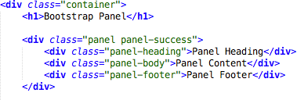
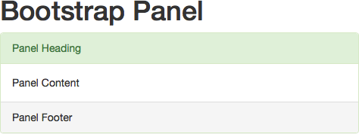
2/6/2019
Bootstrap
27
Bootstrap Panels

Slide 28
2/16/2019
Bootstrap
32
References
w3schools. Bootstrap 3 Tutorial. https://www.w3schools.com/booTsTrap/default.asp
Source Code
https://github.com/tesfayegari/bootstrap

